Slide 1
InHandCash
A next generation upi

Slide 2
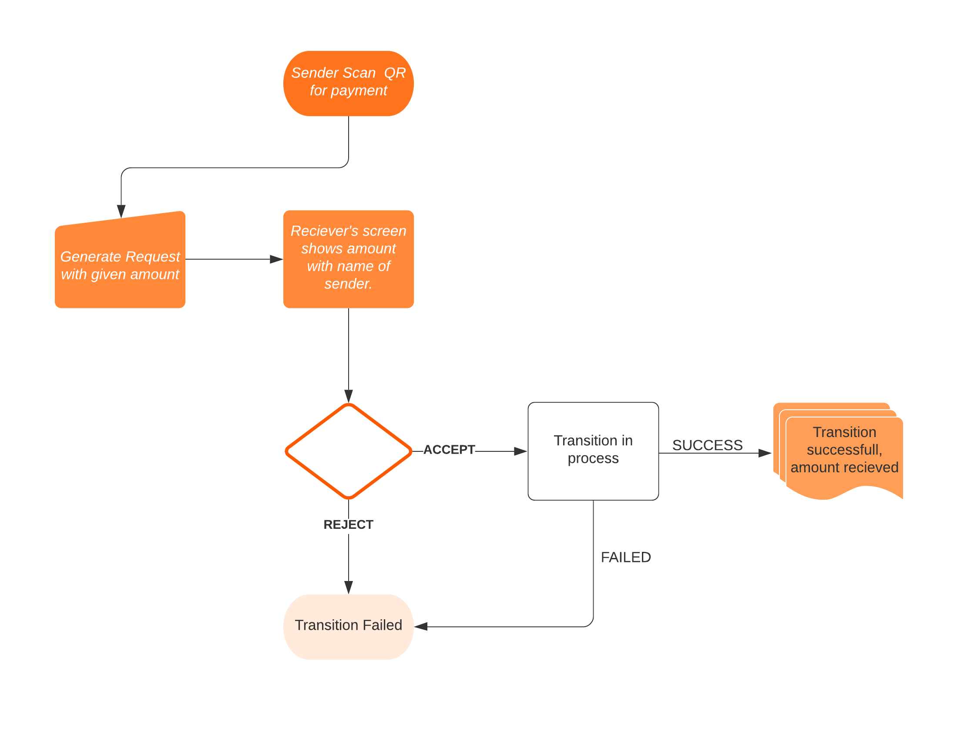
Working Flow Chart

Slide 3
SOLUTION FOR SELLERS
No Fraud & Spoof
Realtime Payments
Trustworthy Platform

Slide 4
Technology, architecture
Django framework
Digital Ocean
Websockets
Android
Firebase
Material Design

Slide 5
OUR TEAM
Pankaj Sharma (Leader)
Shubham Chaudhary
Founder of Bekaim.com.
6 years of full stack development experience.
Pursuing Computer Science Engineering from LPU.
Co-Founder of Bekaim.com.
Has 3 years of full stack development experience.
Pursuing Computer Science Engineering from LPU.

Slide 6
THANK YOU!
It will be helpful if experienced people like you will give us your valuable feedback & suggestions.
pankajsharmamails@gmail.com
+91-9511564460

